Slide 1




G.H. RAISONI COLLEGE OF ENGINEERING
AND MANAGEMENT, WAGHOLI, PUNE.
Department of AI & AIML
Handwritten digit classification
Guide:
VAISHALI BAVISKAR
Name of Projectees
B33 Shivamkumar Sen B32 Sakshi Gupta <

Slide 2
Contents
Introduction
Justifications for Selecting the Title
Problem Statement
Literature Survey
Block Diagram
Expected Result
Work plan
References

Slide 3

Introduction
Handwritten Digit Classification Project
Why Handwritten Digit Classification?
- Automation: Reduce manual efforts in reading and transcribing handwritten digits.
- Efficiency: Accelerate processes in multiple domains.
- Accessibility: Enhance accessibility for visually impaired individuals.

Slide 4
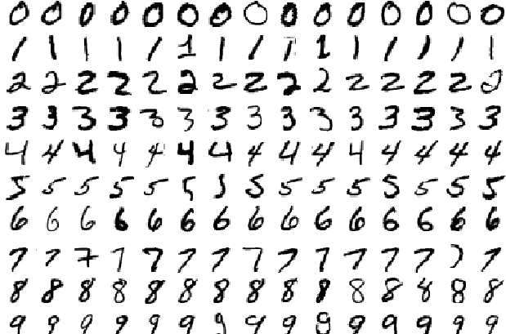
Justification For Selecting The Title
Variability in Handwriting
Overfitting
Limited Dataset Size
Class Imbalance
Noise and Distortions
Ambiguity

Slide 5
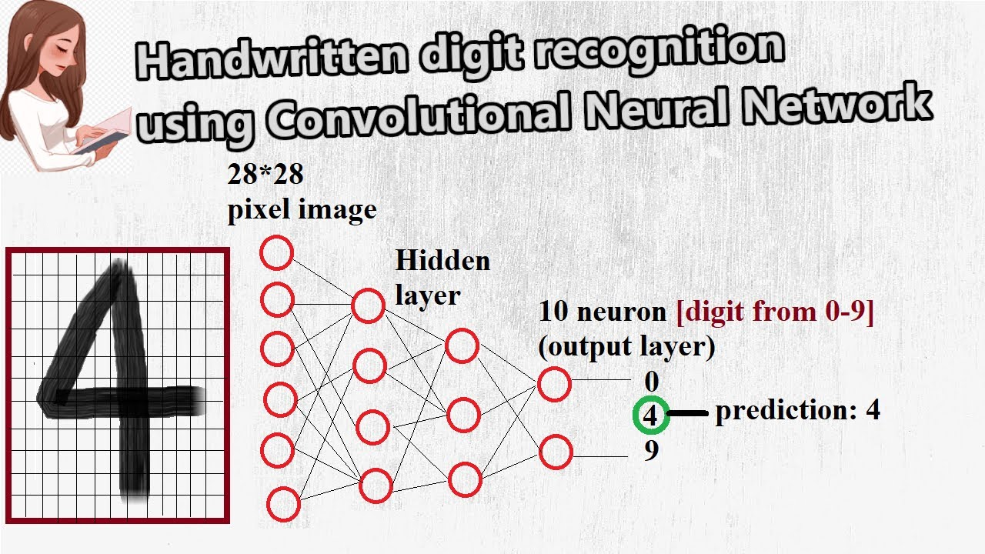
Problem Statement
Data Collection:
Gather a dataset of handwritten digits. A common dataset for this task is MNIST, which contains thousands of handwritten digits (0-9) in grayscale images.
Split the dataset into a training set (used to train the model) and a testing set (used to evaluate the model's performance).
Data Preparation:
Normalize the pixel values of the images to a standardized range (e.g., [0, 1]) to ensure consistency.
Optionally, perform data augmentation techniques to increase the dataset's size and robustness by applying random transformations like rotations and flips.
Model Architecture:
Design a Convolutional Neural Network (CNN) architecture suitable for image classification. A typical architecture includes convolutional layers, pooling layers, and fully connected layers.
Configure the number of layers, filter sizes, and the architecture's complexity based on the project's requiremen
Training:
Feed the training data (handwritten digit images) into the CNN.
The CNN learns to extract features from the images during training.
Adjust the model's parameters (weights and biases) using optimization techniques like gradient descent to minimize a loss function that measures the difference between predicted and actual labels..
Validation and Fine-Tuning:
Continuously monitor the model's performance on a validation dataset during training.
Fine-tune hyperparameters (e.g., learning rate) and architecture based on validation results to improve performance..

Slide 6
Literature Survey
Sr. No. | Paper Title and its Author | Details of Publication | Findings
1 | Handwritten Digit Recognition Using Machine Learning Rabia KARAKAYA | Sakarya University Journal of Science | E-book
2 | HANDWRITTEN DIGIT RECOGNITION USING OPENCV AND CNN Venkateshwar Rao | International Journal of Creative Research Thoughts (IJCRT) | E-book
3
4
5
6

Slide 7
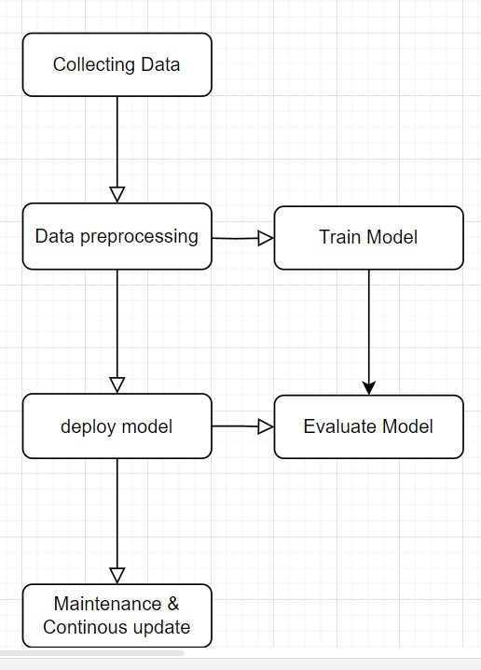
Block Diagram

Slide 8
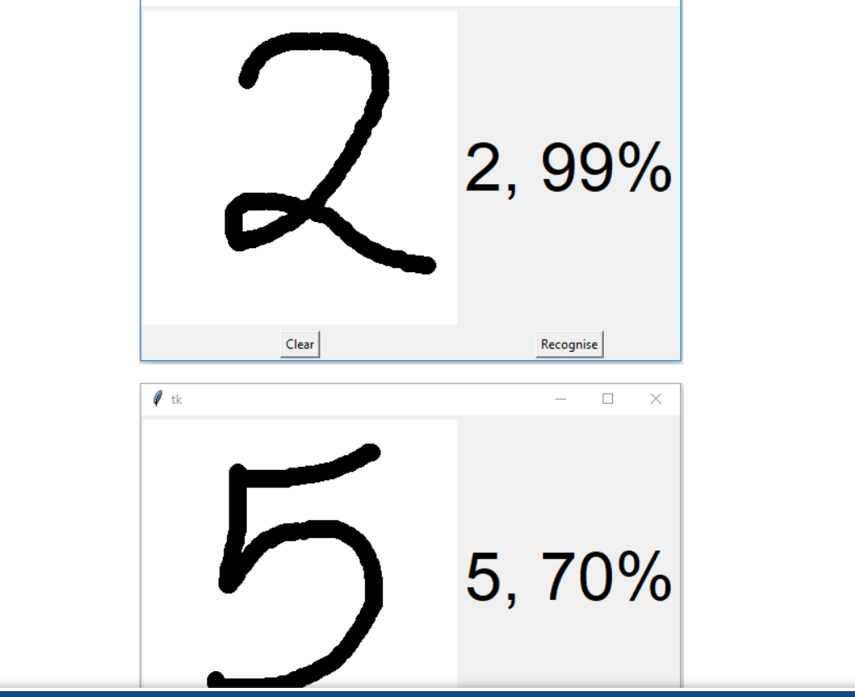
Expected Result
Here are the expected results of a Handwritten Digit Classification project in bullet points:
- High Accuracy in Digit Recognition
- Robustness Across Various Handwriting Styles
- Real-Time or Near Real-Time Inference
- User-Friendly Interface
- Generalization to New, Unseen Digits
- Error Analysis for Model Improvement
- Applicability in Real-World Scenarios
- Scalability to Other Characters or Symbols
- Maintainability and Periodic Updates
- Resource Efficiency for Different Platforms
- Positive User Feedback and Satisfaction
- Tangible Benefits in Time Savings and Efficiency

Slide 9
Work – Plan
Months Activities | August’23 | Sept’23 | Oct’23 | Nov’23
Literature Reviews | √
Requirement Analysis | √
Designing | √
Experimental Analysis | √ | √ | √
Module wise Implementation |  | √ | √
Testing and Debugging |  |  | √ | √
Preparation of Project Report |  |  |  | √

Slide 10
References
https://www.kaggle.com/code/itsmohammadshahid/7-cnn-handwritten-digit-recognition
https://www.kaggle.com/code/itsmohammadshahid/7-cnn-handwritten-digit-recognition

Slide 11
Thank you !

